Slide 1
Linear Regression
Assignment
Vismaya vt

Slide 2
Assignment-based Subjective Questions
i) From your analysis of the categorical variables from the dataset, what could you infer about their effect on the dependent variable?
Ans) The fall has the greatest demand for bikes.
• Springtime sees a decline in bike demand.
• The demand for bikes in 2019 is more than in 2018.
• From May through October, there is a significant demand for bikes.
When the weather is bright or partly cloudy, there is a strong demand for bicycles; when it is rainy or snowy, there is a low demand.
• Bicycle demand is essentially constant during the workdays.
•The demand for bikes remains constant whether a day is a working day or not.

Slide 3
ii)Why is it important to use drop_first=True during dummy variable creation? Ans) Since it can be utilized to remove superfluous columns while establishing dummy variables, it is crucial to obtain k-1 dummy variables. As an illustration, consider the three variables we have: furnished, semi-furnished, and unfurnished. We can just consider two variables: furnished (1-0) and semi-furnished (0-1).Since we already know that 0-0 denotes unfurnished, we don't need to include unfurnished. so that we can get rid of it .Reduction the collinearity between dummy variables is another purpose for it.

Slide 4
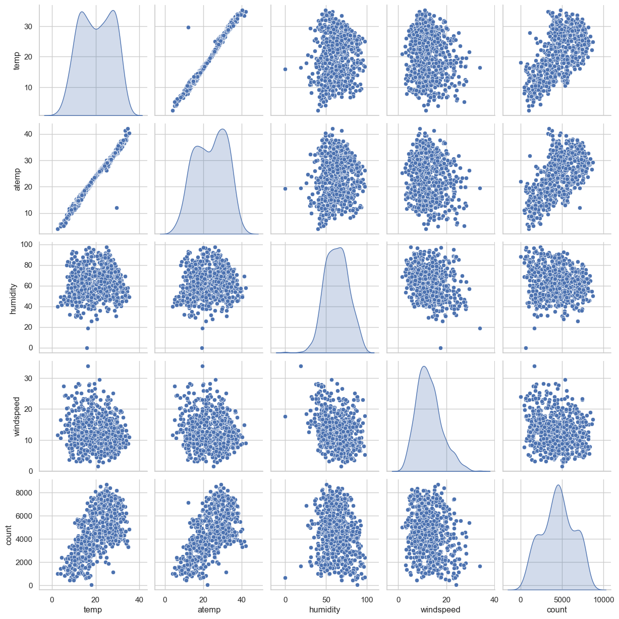
iii)Looking at the pair-plot among the numerical variables, which one has the highest correlation with the target variable? Ans) temp' variable has the highest correlation with the target variable.
).

Slide 5
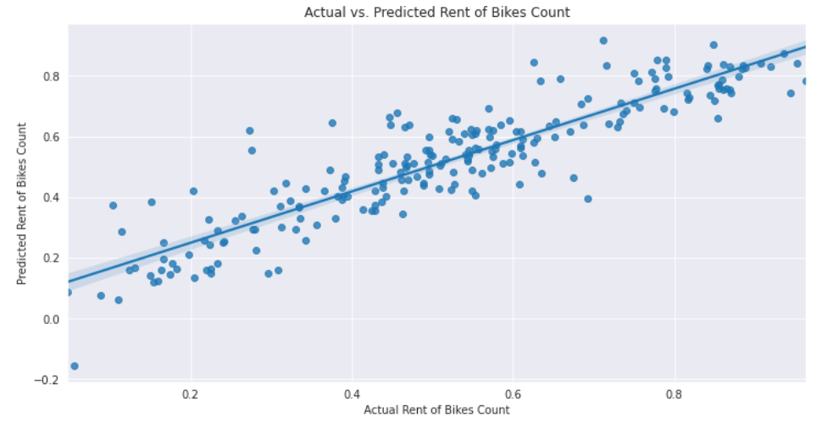
iv) How did you validate the assumptions of Linear Regression after building the model on the training set?
Ans) A basic tenet of a linear regression model is that, when shown on a histogram, the error terms ought to align with a normal curve. We observed the same thing on Out [28]. Thus, this presumption is supported.
1. Linear relationship between independent and dependent variables: As seen in the following image, the linearity of the relationship is confirmed by examining the points that are symmetrically distributed around the diagonal line of the actual vs. predicted plot.

Slide 6
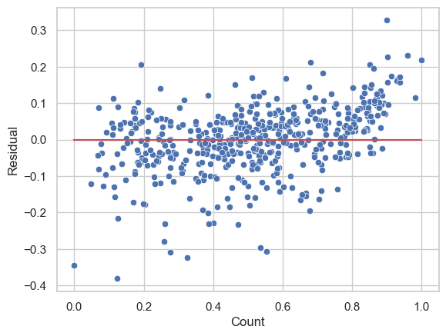
2. Mistake terms are independent of one another - Since there is no discernible pattern in the error terms concerning prediction, we can state that the error terms are independent of one another.

Slide 7
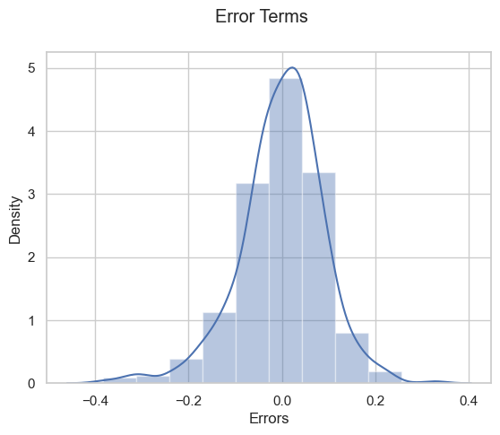
3. Error terms have a normal distribution: An understanding of the error terms' normal distribution and the mean of 0 can be gained from a histogram and distribution plot. The same is seen rather clearly in the figure below.

Slide 8
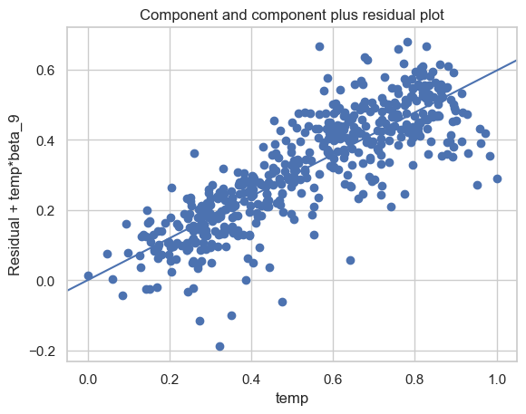
4. Error terms have constant variance (homoscedasticity): As we can see, error terms roughly follow the assumption of homoscedasticity because of their constant variance.

Slide 9
v) Based on the final model, which are the top 3 features contributing significantly towards explaining the demand of the shared bikes?
Ans) The features with the greatest coefficients are the top three features that directly affect the count. These are: temperature, year (which influences positively), and precipitation and snowfall (which influences negatively).
The first three factors are:
weather: The single most important factor that has a beneficial impact on business is temperature. Other environmental factors, such as humidity, wind speed, rain, and cloud cover, have a negative impact on business.
Year: Considering the geological characteristics, the growth appears organic year after year.
Season: The need for shared bikes is mostly influenced by the winter months.

Slide 10
GENERAL SUBJECTIVE QUESTIONS
Explain the linear regression algorithm in detail.
Ans) Linear regression is an interpolation method used to forecast correlation between variables and the degree to which a dependent variable affects an independent variable.We divided the dataset into two parts: the training set, which would be used to train a model, and the testing set, which would be used to see how close our model was to the actual output, after looking over the data and cleaning it using exploratory data analysis. We arrive at a final model by dealing with/dropping the necessary columns, repeating the processes (feature reduction), evaluating the collinearity of variables, utilizing the required variables to train the model, and evaluating the R-value of the model and the p-values of dependent variables.
We then test the model using the test dataset in accordance with the requirements of linear regression, which stipulate that the error curve must be normal. As a result, the model's conclusion would be used to offer insightful analysis and forecasts for datapoints inside the model's range.

Slide 11
2) Explain the Anscombe’s quartet in detail.
Ans) Anscombe's quartet is a famous example in statistics that demonstrates the importance of visualizing data before drawing conclusions. It consists of four datasets that have nearly identical simple descriptive statistics (mean, variance, correlation, and linear regression line), yet they exhibit markedly different patterns when graphed.
It is not always the case that a regression model is exact; some intelligent data can trick it! There are instances where there are several datasets that are very dissimilar, but the regression model appears the same after training. The Anscombe's quartet is a collection of four such datasets with similar descriptive statistics but a few differences.

Slide 12

3) What is Pearson’s R?
Ans) Pearson's correlation coefficient, often denoted as rr, is a statistical measure that quantifies the strength and direction of the linear relationship between two continuous variables. It was developed by Karl Pearson, a British mathematician, in the late 19th century.
The degree of correlation between two variables is expressed as Pearson's correlation coefficient, or Pearson's R. It's frequently applied to linear regression. A perfectly positive and linear correlation is shown by a value of +1 for Pearson's R, whereas a perfectly linear negative regression is indicated by a value of -1. The relative collinearity of two variables is indicated by the values in between.
$$r= \frac{n\left(Σx∗y\right)−\left(Σx\right)∗\left(Σy\right)}{\sqrt{\left[nΣx^{2}−{\left(Σx\right)}^{2}\right]∗\left[nΣy^{2}−{\left(Σy\right)}^{2}\right]}}$$

Slide 13
4) What is scaling? Why is scaling performed? What is the difference between normalized scaling and standardized scaling?
Ans) Scaling is a preprocessing technique used in data analysis and machine learning to transform the features of a dataset to a similar scale. It involves adjusting the range of values of the features so that they all have similar magnitudes. Scaling is performed to ensure that no single feature dominates the analysis or the algorithm's learning process due to having a larger magnitude of values compared to other features.
A model cannot function properly with the wrong range of coefficients unless it is scaled. For example, if the sale of a car was reliant on two independent variables, price and months, the price range would be much too high because there are only 12 months in a year. Then, appropriately adjusting the variable price will prevent decimal errors from occurring in the model. Two categories of scaling exist:
Normalized scaling: This technique is used to transform the data distribution into a Gaussian distribution. There isn't a predetermined range for it. widely utilized in neural networks.
Scaling: One illustration of standardized scaling is provided above. In this case, the variable(s) values are condensed into a particular range in order to fit the model.

Slide 14
5) You might have observed that sometimes the value of VIF is infinite. Why does this happen?
Ans) Yes, encountering infinite values of Variance Inflation Factor (VIF) is not uncommon in statistical analysis, particularly in regression analysis. VIF is a measure used to detect multicollinearity among predictor variables in a regression model. It quantifies how much the variance of the estimated regression coefficients is inflated due to multicollinearity.
The reason why VIF can become infinite is usually due to perfect multicollinearity among predictor variables. Perfect multicollinearity occurs when one predictor variable in a regression model can be exactly predicted by a linear combination of other predictor variables.
The R-squared value equals one if there is perfect correlation between the independent variable(s) and the dependent variable. As a result, VIF, or (1/(1-R^2)), approaches infinity.

Slide 15
6) What is a Q-Q plot? Explain the use and importance of a Q-Q plot in linear regression?
Ans) The quantile-quantile graphs are called Q-Q plots. A graphical tool is utilized to evaluate whether the two data sets have a common distribution. There are three possible types of theoretical distributions: normal, exponential, and uniform. In linear regression, the Q-Q plots help determine if the train and test data sets come from populations with similar distributions. Here's another way to verify that the data sets' normal distribution is a straight line with the patterns described below.
• Interpretations
o Similar distribution: When every quantile data point is positioned at a 45-degree angle to the x-axis and surrounds a straight line.
o Y values less than X values: if the quantiles for y-values are smaller than those for x-values.
o X values < Y values: When the quantiles for x values are smaller than those for y values.
o Diverse distributions: These occur when all of the data points are outside of the straight line.

Slide 16
• Benefits
o From a single plot, distribution features such as loc, scale shifts, symmetry modifications, and outliers can all be finely tuned.
o There is a provision in the plot to include the sample size.

Slide 17
THANKYOU!

